Slide 1
JAVA ARCHITECTURE
DONE BY MANISHA KUDCHI

Slide 2
Java ARCHITECTURE
Java Architecture is a collection of components are JVM, JRE, and JDK.
It integrates the process of interpretation and compilation. It defines all the processes involved in creating a Java program.
Java Architecture explains each and every step of how a program is compiled and executed.
There is a process of compilation and interpretation in Java.
Java compiler converts the Java code into byte code.
The JVM converts the byte code into machine code.
The machine code is then executed by the machine.

Slide 3
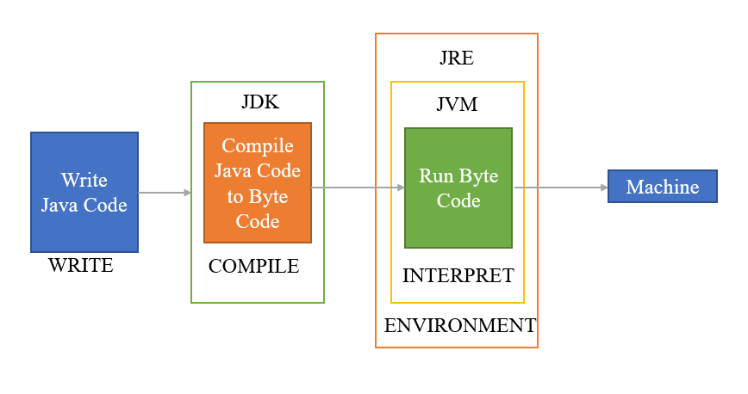

Slide 4
JAVA DEVELOPMENT KIT (JDK)
Java Development Kit is a bundle of software development tools and supporting libraries combined with the java Runtime Environment(JRE) and java Virtual Machine(JVM)
Installing a JDK in your development environment is used to compile a java program.
JDK is used to compile the JAVA code(High Level Language) to Byte code(Intermediate Level Language).
This process comes under Compilation Phase.

Slide 5
JAVA RUNTIME ENVIRONMENT(JRE)
The Java Runtime Environment(JRE) is software that Java program require to run correctly.
Java is a computer language that powers many current web and mobile application.The JRE is the underlying technology that communicates between the java program and the operating system
JRE provides an environment in which java program are executed.
JRE takes our java code,integrates it with the required libraries,and then starts the JVM to execute it

Slide 6
JAVA VIRTUAL MACHINE(JVM)
A Java Virtual Machine(JVM) is a program that interprets java byte code to run as a program by providing a runtime environment that executes this process.
It is a software which takes Java byte code and converts the byte code into machine understandable code(Machine Level Language).
This process comes under Execution Phase.

